Slide 1

Slide 1
Car Insurance claims
-Harshit Singh

Slide 2
Slide 10
Problem Statement
Develop a predictive model that assesses the claim probability for car insurance policies. The objective would be to understand the factors that influence claim frequency and severity in the period of six months and enable insurance companies to better assess risk and determine appropriate premiums for policyholders.
10

Slide 3
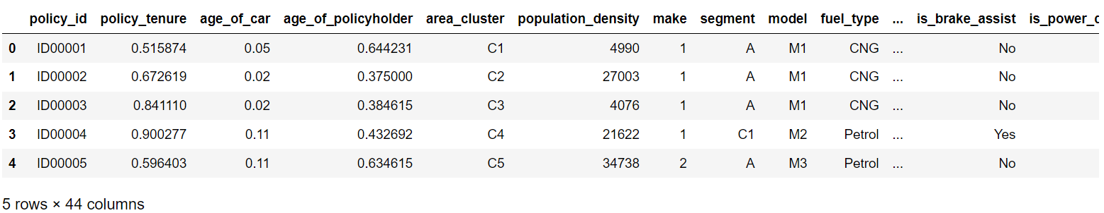
Slide 10
About
Data
The Number of Rows :58,592
The Number of Columns :44
10

Slide 4
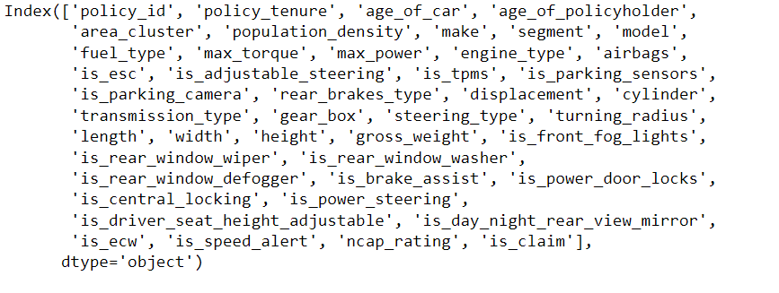
Slide 10
Datatype:
Integer- 12 columns
Float-04 columns
Object-28
Data
Info.
10

Slide 5
Slide 10
Handling Binary Columns
Following are the Binary columns :
"is_esc", "is_adjustable_steering",
"is_tpms", "is_parking_sensors","is_parking_camera","is_front_fog_lights",
"is_rear_window_wiper", "is_rear_window_washer",
"is_rear_window_defogger", "is_brake_assist", "is_power_door_locks",
"is_central_locking", "is_power_steering",
"is_driver_seat_height_adjustable", "is_day_night_rear_view_mirror",
"is_ecw", "is_speed_alert“
Replaced “Yes “ with 1 and “No” with 0
EDA
2. Handling Categorical Columns
Following are the Binary columns :
fuel_type: replaced CNG with 1 , Petrol with 2 and Diesel with 3
rear_brakes_type: replaced Drum with 1 and Disc with 2
transmission_type: replaced Manual with 1 and Automatic with 2
steering_type: replaced Power with 1, Electric with 2 and Manual with 3
10

Slide 6
Slide 10
3. Encoding
One Hot Encoding was implemented on following columns:
area_cluster
Segment
max_torque
engine_type
model
EDA
10

Slide 7
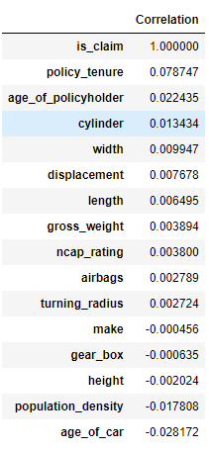
Slide 10
Correlation with the Target Variable(Claims)
Topmost Correlated Features:
1.Policy Tenure
2.Age of the policy holder
Correlation
10

Slide 8
Slide 10
Recursive Feature Engineering (RFE)
Recursive Feature Engineering (RFE) is a technique used in machine learning to iteratively select the most relevant features for model building. It aims to improve model performance by reducing the feature space, enhancing model interpretability, and decreasing computational complexity.
Parameters:
Model- Logistic Regression
Features-15
Feature
Selection
10

Slide 9

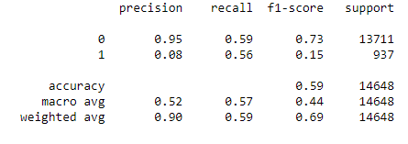
Slide 7
1. Logistic Regression
35%
Parameter:
Features=15
Classification Report
43%
Modelling

Slide 10
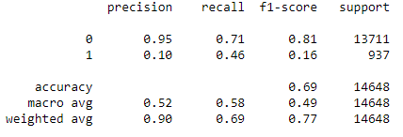
Slide 7
2. Random Forest
35%
Parameter:
Max Depth=15
n_estimator=150
Features=0.3
Classification Report
43%
Modelling

Slide 11
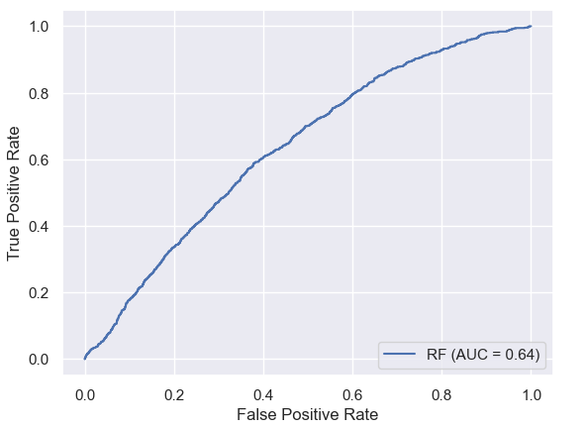
Slide 7
Graph
Random Forest
ROC AUC Curve
35%
43%

Slide 12
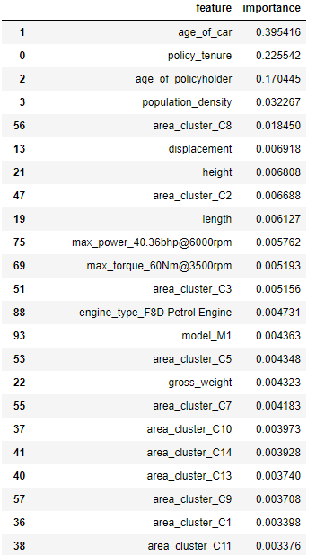
Slide 7
Feature Importance
35%
Topmost Features:
Age of Car
Policy Tenure
Age of Policy Holder
43%
Features

Slide 13

Slide 11
THANK YOU

